Slide 1
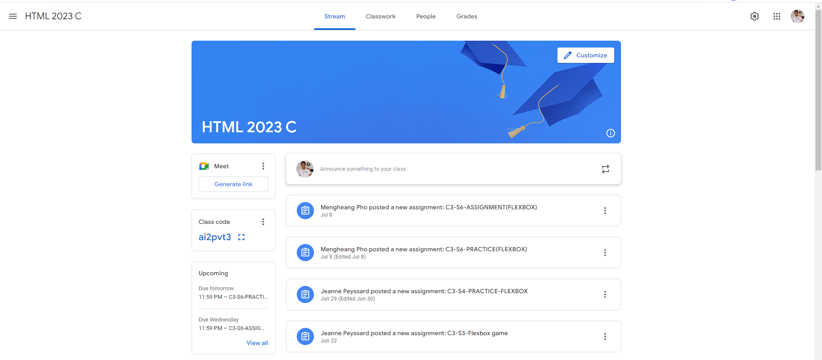
Identify root components of website below

Slide 2
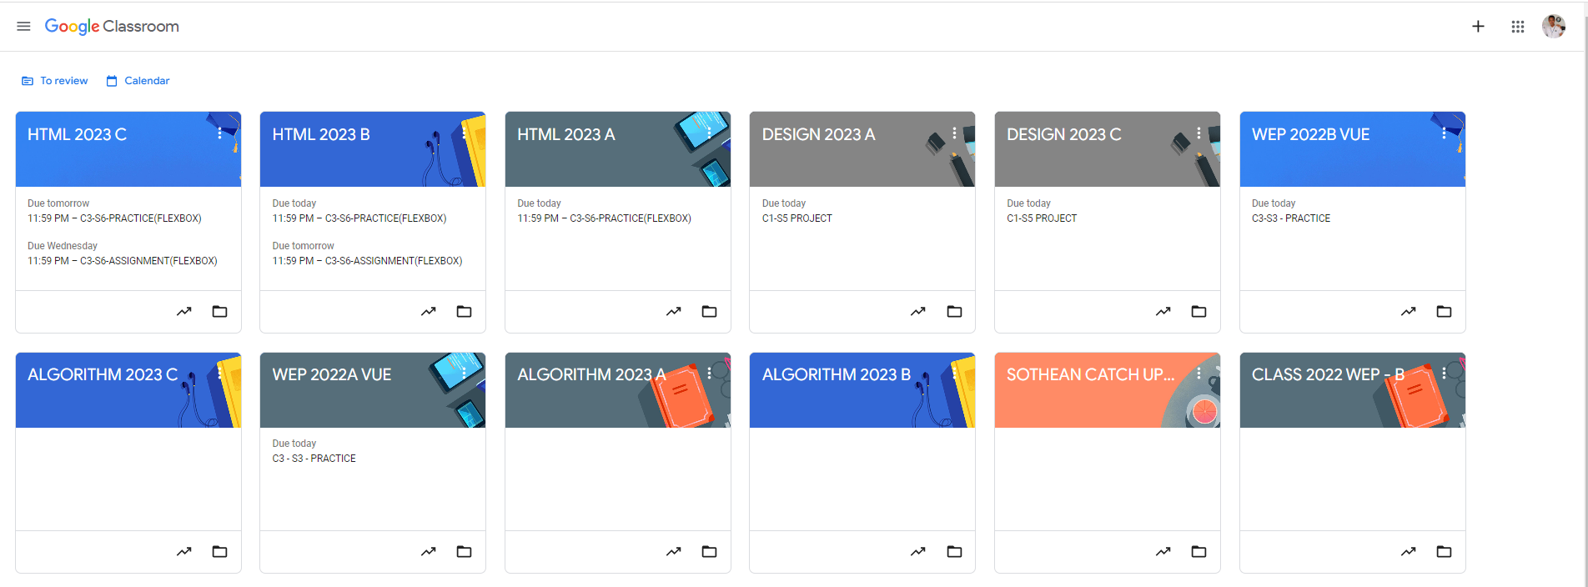
Root div
- Height: 100vh
content
nav
Flex: 0
header
Flex: 0
Flex: 1

Slide 3
Main
Navigation
Header

Slide 4
Left-nav
Center-nav
Right-nav
Flex 0
Flex 1
Flex 0
Flex-direction: row;
Header
Flex 0

Slide 5
Sidebar
Content
Flex 0
Flex 1

Slide 6
Flex 0
Announcement
Message Content
Flex 1

Slide 7
Announce Post
Profile
Messages

